Slide 1

Drumea Alexandru-Daniel
Coordonator: Prof. Dr. Cristea Dan

Slide 2
The Problem?
How can one facilitate the summarization of CVs in order for HR departments to process large quantities of data?
How can one efficiently analyze data in Customer Support such that the response for a complaint to be forwarded to the appropriate department to handle?
Notes:
In a world of fast data travelling and automated tasks, there still are grueling, time consuming tasks one has to perform
Large quanities of digital data now-a-days
Some time consuming tasks are better performed by using software solutions, such as:

Slide 3
The Solution?
NER – Named Entity Recognition
A subtask of information extraction that seeks to locate and classify mentions of known named entities
The categories?
Person names, organization/departament names, geographical locations and miscellaneous
Notes:
in unstructured texts into pre-determined categories
such as date and time, geo-political relations, works of art etc.

Slide 4
State-of-the-art
The Stanford Named Entity Recognition Software
The SpaCy Entity Recognition
The Gazetteer Method
Notes:
Current software solutions to this are
First: used for academic purposes, has language independent support, is easy to use
Second: industry standard, used by Airbnb, Quora (tech blog) etc.
Brute force method, useful when there is little context

Slide 5
The Stanford Named Entity Recognition Software
Uses the Conditional Random Field Algorithm in order to predict the features of an unknown word.
All word features are stored in a window
The Stanford Named Entity Recognition Software is highly used in the academical purposes
Notes:
Conditional Random Field Algo: uses the conditional probability function to tag unannotated words, based on the previous sequence
Tags the word in the most likely way, based on the training data
Word features: lemma, number, part of speech, also prev word, next word
Easily extendable to other languages
Training method to be presented

Slide 6
SpaCy
Free, open source library that has made Natural Language Processing (NLP) much simpler in Python.
Provides users with a statistical system which is highly efficient for named entity recognition
Uses Convolutional Neural Networks
Notes:
CNN to extract features (very good)
Also uses windows to store word features
Convolution filter applied to each window
The exact implementation is not revealed to the general public – used in production

Slide 7
Gazetteer
It implies the creation of a different list for each of the type of entities.
Tag the unannotated body of text using a Part of Speech Tagger
Search the respective lists for each word / group of words identified by the Part of Speech Tagger
Notes:
Stanford POS Tagger has support for the Romanian language, uses CRF algorithm similarly as the named entity recognition software

Slide 8
Application of NER for the Romanian Language
The aforementioned methods provides an accuracy score of over 90% for the languages they are trained on.
For the Romanian Language? Not so good.
The problem?
Scarce models for this language, complexity of the topic of the language.
The Solution?
Combining the three methods using a voting function
Notes:
Term accuracy to be defined later
Training Stanford Romanian corpora, using the multi-language support of SpaCy, comprising the gazetteer
Combining the adapted three methods

Slide 9
QuoVadis & RONEC
QuoVadis
A corpus displaying semantic relations in free text.
The knowledge base is built in such a way as to facilitate the training of programs aiming to automatically recognize text entities and semantic relations.
RONEC
A corpus of annotated data consisting of 5127 sentences with a total of 26376 entities
Notes:
2 sources of information
Combined and formatted in a trainer friendly way, uniform across the application

Slide 10
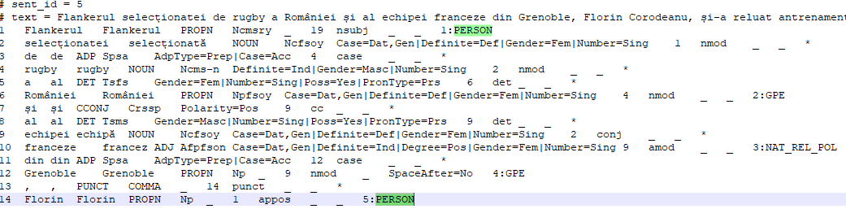
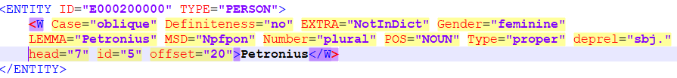
Formats
RONEC
QuoVadis
Notes:
Whole sentence in a comment
Each line is a word with a lot of features
Xml document, has exactly the same features, in another format
Interested in the <entity> </entity> attributes

Slide 11
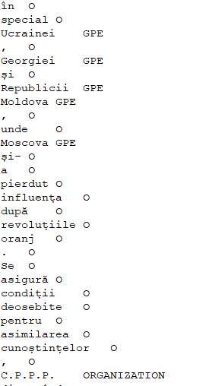
The Format of the Training Data
The format is the ConLL-U Plus format.
The values are stored in two columns separated by <tab>.
Every word and punctuation sign is a new line.
Facilitates the training of the model.
Notes:
- Comments are removed

Slide 12
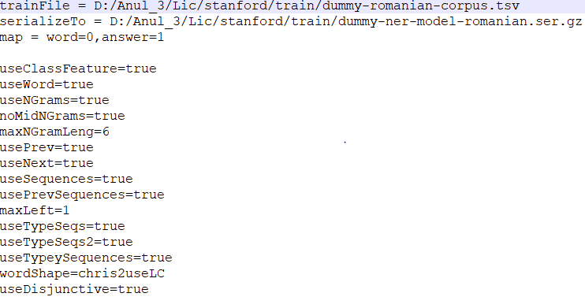
Training the corpus
Write the proprieties file.
Run the Stanford Trainer.
Notes:
Train file is the aforementioned training data file
Serialize to is the output of the trainer
Map specifies the format of the train file
Trainer is written in java
Explain params
SpaCy has been trained using the multi-language model, Gazetteer has been comprised

Slide 13
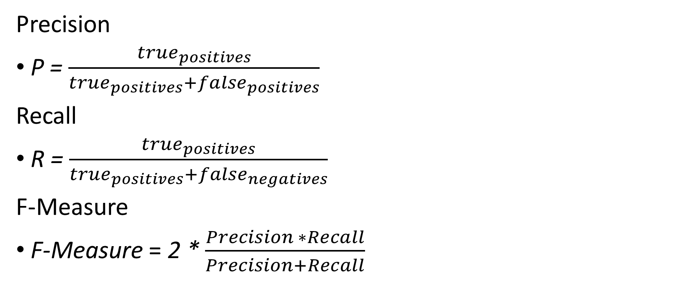
Metrics
Precision
P = $\frac{true_{positives}}{true_{positives}+false_{positives}}$
Recall
R = $\frac{true_{positives}}{true_{positives}+false_{negatives}}$
F-Measure
F-Measure = 2 * $\frac{Precision ∗Recall}{Precision+Recall}$
Notes:
Having trained, and checked a test classification, one must measure each method’s performance, for that define the measurement methods for performance
True pos=, if the word is a named entity, the classifier tagged the word as a named entity, and the category attributed the word is correct.
False positive = one calls a false positive a word which is not a named entity, but has been classified as such.
False negative =either a named entity which has not been classified at all, or one which has been wrongly classified

Slide 14
Statistics
The test values file is composed of 20 pieces of text.
2 characteristics for each sentence: raw text and manually annotated
Comprise each category (false positives, true positives, false negatives)
Compute each metric.
Notes:
made a test file
Dictionary, 2 entries: raw, annotated text (manually)
Comprised using python
Applied the aforementioned formulas for each classifier

Slide 15
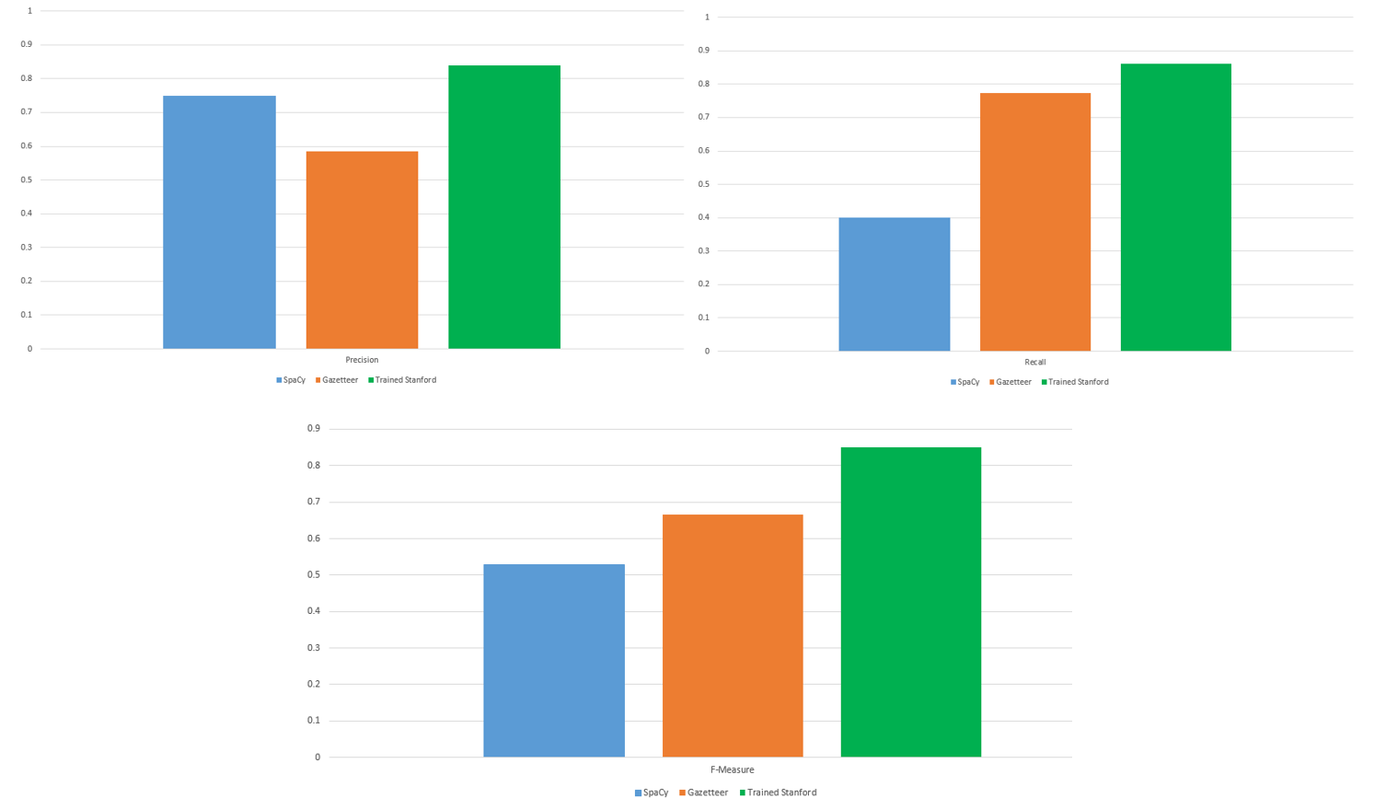
Results
Notes:
- We tested all three methods and the results are

Slide 16
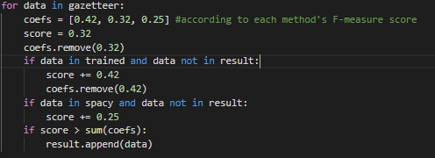

Voting
The influence on the final result will be the result of a weighing formula.
$w_{i}$ = $\frac{f_{i}}{\sum_{i=1}^{3}{f_{i}}}$
The weights of each method: 0.42, 0.32, 0.25
Notes:
For combining all three methods we need a voting function in order to obtain better performance
Compute the score of each tagged entity from each classifier (according to each weight), then check if the remaining sum of weights is greater than the score of the classification
If that is the case, the classification will not be in the results

Slide 17
Web Application
Fairly simple.
The user input is extracted from the frontend.
Passed on to the voting function.
The voting function will apply the named entity recognition algorithm.
A beautify function will return the HTML friendly code to the frontend.
DEMO
Notes:
- We move on to the demonstration

Slide 18
Conclusions
The F-Measure score reached is 88%.
The most influent classification is the Stanford NER.
The Gazetteer method is best with person names.
SpaCy is best with noun-phrases.
Improvements are required in the form of larger, more comprehensive corpora, larger, more ambiguous contexts.
Notes:
due to its language independent platform
Because of the fact that the name file is significantly larger than the others + usually one word
Because it extracts the features of a word better

